Slide 1
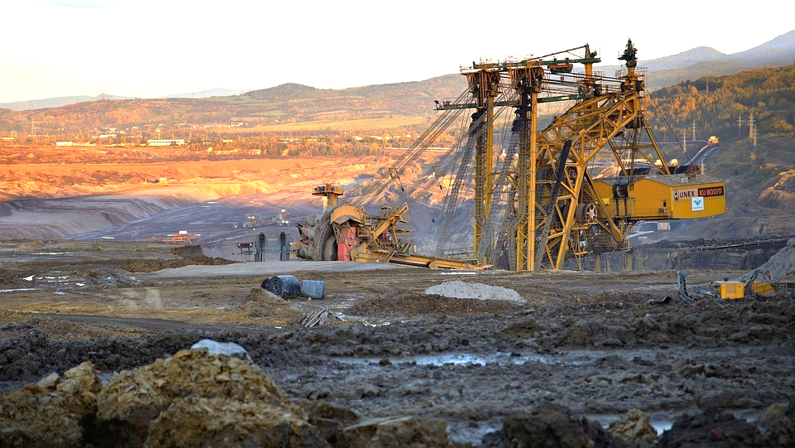
ENERGY SOURCES
We will select energy sources for specific situations.
Notes:
Insert cover image and use transparency settings to fade image.

Slide 2
Do not delete this slide.
This slide is designed so that you can copy the prompt box you need and insert it into your slides.
This slide is hidden and will not be included when presenting your lesson.
TRACK WITH ME
VOCABULARY
1 -
HINT
Students, remember….
CHECK FOR UNDERSTANDING
READ WITH ME
TEACHER CUE
MAKE THE CONNECTION
Students, you already know….
EXTENSION
GESTURE WITH ME

Slide 3
Categorise these energy sources as renewable or non-renewable.
Examples | Renewable | Non-Renewable
Solar Energy
Wind Power
Gas
Hydro Power
Oil

Slide 4
Repeat the opposite word/phrase.
RENEWABLE
WILL NOT RUN OUT

Slide 5
Repeat the opposite word/phrase.
NON-RENEWABLE
WILL RUN OUT

Slide 6
We will select energy sources for specific situations.
TRACK WITH ME
READ WITH ME
We will choose energy sources based on cultural, economic and moral factors.
DECLARE THE OBJECTIVE
Read the learning objective to your partner.
Notes:
Learning Objectives contain concepts (nouns, big ideas), skills (verbs, measurable behaviours) and sometimes context (restricting or targeting conditions).
●Example: Students will be able to describe the concept of density and apply it to floating and sinking.
●
Success criteria are specific measurable outcomes that if met mean that the student has met the learning objective.
Examples:
•Students will be able to compare densities of substances using mass and volume.
•Students will be able to identify whether a solid or liquid will float or sink in a liquid based on their densities.

Slide 7
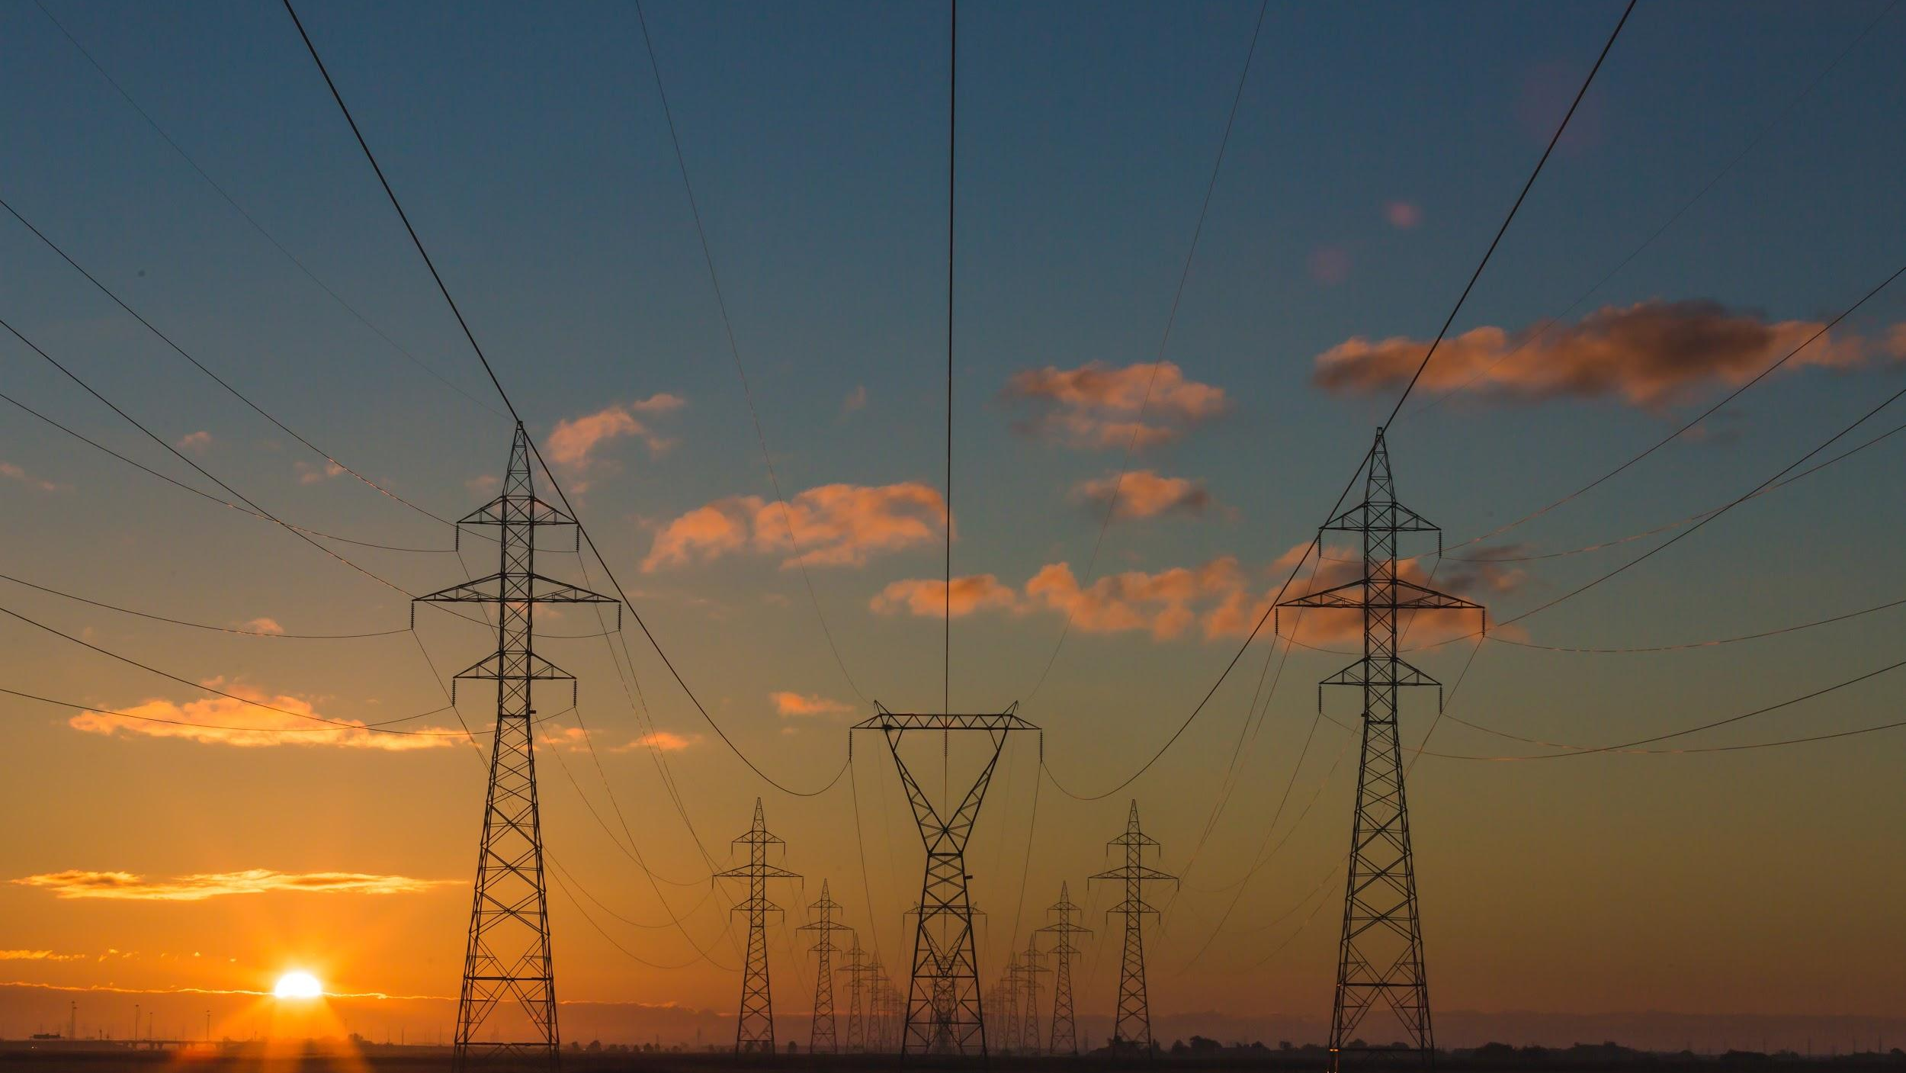

We will select energy sources for specific situations.
You already know that energy sources can either be renewable or non-renewable.
Renewable energy sources will not run out.
Non-renewable energy sources will run out.
Do you think humans mainly use renewable or non-renewable energy sources? Why?

Slide 8
We will select energy sources for specific situations.
More than 80% of the world’s energy supply comes from coal, oil and gas. These are all non-renewable energy sources.
Australia has plentiful₁ supplies of coal and it is relatively cheap. Major energy sources used in Australia include:
black and brown coal, to produce steam used to generate most of our electricity
petrol to power most of our cars, with some using LPG (liquefied petroleum gas, another fossil fuel)
diesel to power most trucks and some trains
natural gas for much of our cooking, central heating and hot water services.
CHECK FOR UNDERSTANDING
Why do you think 80% of the world’s energy supply comes from non-renewable resources?
VOCABULARY
1 - great quantities

Slide 9
We will select energy sources for specific situations.
CHECK FOR UNDERSTANDING
Why do you think Western societies consume large amounts of energy?
Developed countries such as Australia, United States and European countries consume large amounts of energy.
The table shows energy use per person (GJ) in various countries.
Country | Yearly energy use per person (GJ) [1 GJ = 1000 million J]
Australia | 240
Canada | 348
China | 48
Ethiopia | 12
United Kingdom | 164
United States | 327

Slide 10
We will select energy sources for specific situations.
CHECK FOR UNDERSTANDING
Why do societies need to consider moral factors around energy sources?
Societies need to consider the moral, economic and cultural factors when selecting energy sources.
Moral factors consider whether the energy source feels right use, e.g will it harm the environment.
Economic factors consider whether the energy source will be good for the economy, e.g. create jobs.
Cultural factors is consider whether the energy source is suited to the area, e.g. any landmarks around that can not be disrupted.

Slide 11
We will select energy sources for specific situations.
CHECK FOR UNDERSTANDING
Should we mine coal in the middle of Whiteman Park? What type of factor would we need to consider?
Factors that influence energy source choice for societies.
Factor | Renewable | Non-Renewable
Moral | Natural resources Good for the environment | Creates pollution Not good for the environment
Economic | Expensive to set up Creates new jobs | Cheap Creates new jobs Maintains current jobs
Cultural | Nearby landmarks Nearby Indigenous cultural sites Nearby residential areas | Nearby landmarks Nearby Indigenous cultural sites Nearby residential areas

Slide 12
We will select energy sources for specific situations.
Complete the table in your workbook by filling in the gaps of the table below.
HINT
Students, remember…. Moral factors consider whether the energy source feels right use, e.g will it harm the environment. Economic factors consider whether the energy source will be good for the economy, e.g. create jobs. Cultural factors consider whether the energy source is suited to the area, e.g. any landmarks around that can not be disrupted.
Factor | Renewable | Non-renewable
Moral |  | Creates pollution Not good for the environment
Economic | Expensive to set up Creates new jobs
Cultural | Nearby landmarks Nearby Indigenous cultural sites Nearby residential areas

Slide 13
We will select energy sources for specific situations.
Historically, humans only had basic needs and their energy needs were met from renewable energy sources such as sunlight and burning fuels like wood.
Today, we have a much higher energy needs. This is due to the technology advances such as air travel, car travel and air conditioning.
So we use mainly non-renewable energy sources.
Developed countries such as Australia, United States and European countries consume large amounts of energy.
CHECK FOR UNDERSTANDING
Why do we have much higher energy needs today?

Slide 14
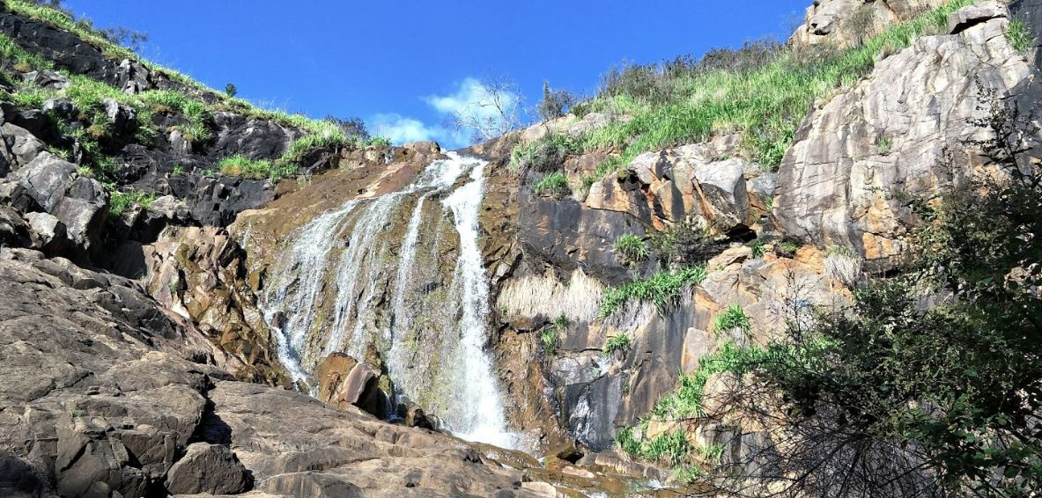
We will select energy sources for specific situations.
Class discussion: What would be the moral, economic and cultural factors of mining non-renewable energy sources in Lesmurdie Falls National Park?
Consider the following:
Is Lesmurdie Falls home to endangered animals?
How close is Lesmurdie Falls to houses?
Are there any indigenous sites in Lesmurdie Falls?
Does the park attract tourism?
Notes:
Please include tasks/questions here rather than just referring to a worksheet. This will save on photocopying and facilitate sharing with other schools.
Try and build tasks/questions which escalate through Bloom’s Taxonomy. This will help with differentiation.

Slide 15
We will select energy sources for specific situations.
We will choose energy sources based on cultural, economic and moral factors.
CHECK FOR UNDERSTANDING
Check Success Criteria.

